Slide 1
Unit 1: Concepts of Motion
Section 1.3
Position and Time, Vectors

Slide 2
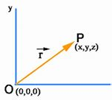
Some Vocabulary!
Position: Where an object is located
Time: When the object was at that position
Position Vector: An arrow drawn from the origin to an object’s position

Slide 3
More on Vectors
Scalar Quantity: Physical quantity described by single number (mass, temp)
Vector Quantity: Cannot be described by a single number because they have a directional quality (motion…you need both speed and direction)
Length of vectors indicate magnitude
Vector symbols have arrows above them!

Slide 4
Displacement
Change in position
A vector quantity because it is expressed with both length and direction
Ex: = 75 ft, northeast

Slide 5
Adding Vectors
*To get the coordinates of the sum, simply add the x’s and the y’s
*To graph:
Draw A (the 1st coordinate)
Place the tail of B (the 2nd coordinate) at the tip of A
Draw arrow from the tail of A to the tip of B

Slide 6
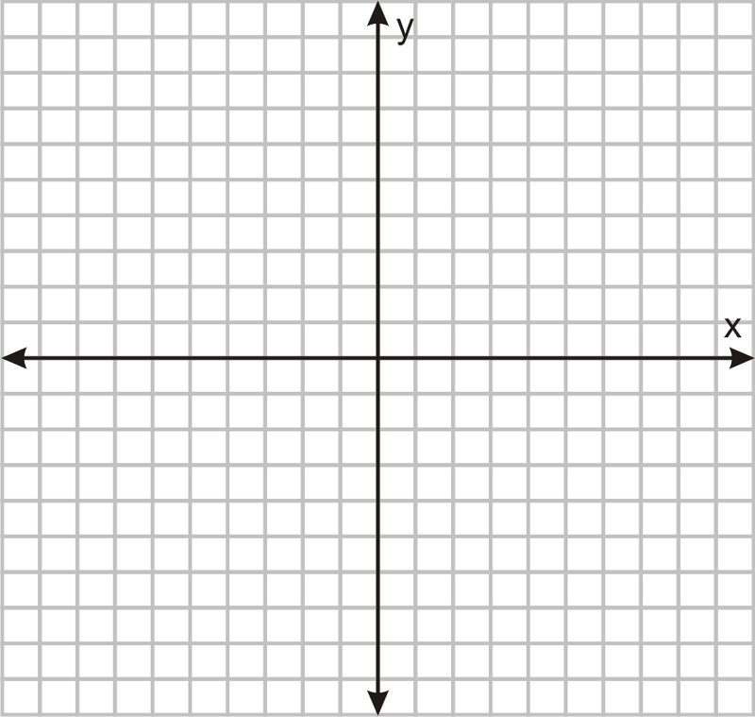
Adding Vectors
Example: What is the sum of vector A (6, -2) and vector B (-4, 4)?

Slide 7
Adding Vectors
Example: What is the sum of vector A (-3, 3) and vector B (5, 2)?
Begin section 1.3 notes and practice.

Slide 8
Subtracting Vectors
*To get the coordinates of the difference, simply subtract the x’s and the y’s
*To graph:
Draw A (the 1st coordinate)
Place the tail of B (the 2nd coordinate) at the tip of A. BUT reverse the signs of x and y for B!
Draw arrow from the tail of A to the tip of B.

Slide 9
Subtracting Vectors
Example:
What is vector A (3, -1) minus vector B (5, 2)?

Slide 10
Subtracting Vectors
Example:
What is vector A (-2, 3) minus vector B (3, -2)?

Slide 11
Time Intervals
Used to show change in time
Formula: ∆t = t_{f} – t_{i}, where t_{f} is time at final position and t_{i} is time at initial position.

